Slide 1


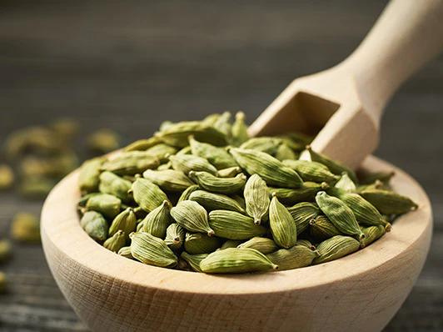








Exploratory Data Analysis and Statistical Insights of Cardamom Auction Data (2015-2024)
Read More
Notes:
"Good [morning/afternoon], everyone. Today, I will be presenting the Exploratory Data Analysis and Statistical Insights of Cardamom Auction Data from 2015 to 2024. The aim of this project is to analyze trends in supply, demand, and pricing, as well as the effects of key market events, such as price spikes and the COVID-19 pandemic."

Slide 2
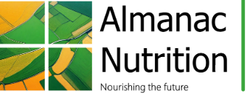
Company Profile
Almanac Nutrition is a distinguished spices trading company dedicated to delivering quality and authenticity in every product. specialize in importing and exporting a diverse range of spices, catering to both local and global markets.
Core Services:
Global Trade Solutions: Facilitating international transactions and logistics with timely delivery and strict adherence to trade regulations and compliance.
Integrated Capital Management: Offering tailored financial solutions and capital management strategies designed to enhance profitability for businesses in the spice trade.
Green Consulting: Providing consulting services focused on sustainable practices, helping businesses adopt eco-friendly solutions and meet environmental standards in the spice industry.
Contact Information:
Address: 4th Floor, Sai Durga Enclave, Bellandur, Bangalore, Karnataka, India, 560103
Email: arshaq@almanacnutrition.com
Phone: +91 (0) 7994333716
Notes:
Before diving into the analysis, let me introduce Almanac Nutrition, a leading spices trading company that specializes in importing and exporting various spices to local and global markets. The company offers global trade solutions, integrated capital management, and consulting services focused on sustainable practices in the spice industry."

Slide 3

Borcelle
Objectives of the Project
Analyze trends in cardamom supply, demand, and pricing between 2015 and 2024.
Investigate the impact of key market events (e.g., price spikes, COVID-19) on cardamom auctions.
Identify correlations between supply, demand, and pricing.
Provide insights into price volatility and market stability.
Provide predictive insights on the effects of supply and demand on prices through regression analysis
Organic Food
Presentations are tools that can be used as lectures.
Notes:
The key objectives of this project are:
Analyze trends in cardamom supply, demand, and pricing from 2015 to 2024.
Investigate the impact of major events like price spikes and COVID-19 on the cardamom market.
Identify correlations between supply, demand, and pricing to understand market behavior.
Provide insights into price volatility and market stability.
Use regression analysis to provide predictive insights on the relationship between supply, demand, and prices."

Slide 4
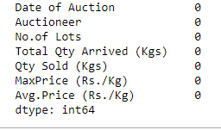
Borcelle
Dataset Overview
The dataset used for this analysis is Cardamom auction data from 2014 to 2024. It includes key indicators of the supply, demand, and pricing of cardamom in India. Below are the main columns:
Date: The date on which each auction took place.
Total Qty Arrived (Supply): The total quantity of cardamom brought to the auction (a measure of supply).
Qty Sold (Demand): The total quantity of cardamom sold during the auction (a measure of demand).
Max Price: The highest price at which cardamom was sold during the auction.
Avg Price: The average price at which the cardamom was sold.
Organic Food
Presentations are tools that can be used as lectures.
Notes:
The dataset includes key indicators for cardamom auctions in India, such as:
Total Quantity Arrived (Supply): This measures the total supply of cardamom brought to each auction.
Quantity Sold (Demand): This measures the demand for cardamom based on the amount sold at each auction.
Max Price and Average Price: The highest and average prices at which cardamom was sold.
By analyzing these variables, we can better understand market dynamics and pricing behavior."

Slide 5
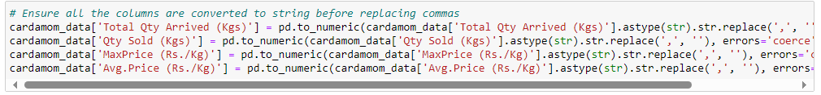
Data Cleaning
Borcelle
Data cleaning steps:
- Removed commas from numerical data
- Converted text to numeric format
- Handled errors (NaN where necessary).
Organic Food
Presentations are tools that can be used as lectures.
Notes:
"One of the first tasks we performed was data cleaning. The original dataset contained commas in large numbers, making the data non-numeric. To enable analysis, we:
Removed commas from the relevant columns like Total Quantity Arrived, Quantity Sold, Max Price, and Avg Price.
Converted the cleaned data to numeric format for further calculations and analysis."

Slide 6
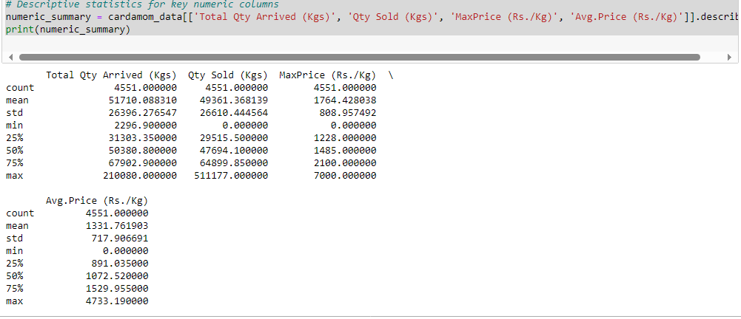
Descriptive Statistics Qty Arrived (Supply)
Borcelle
Mean: 51710 kg, Std: 26396 kg, Min: 2296 kg, Max: 210080 kg.
Interpretation: Supply fluctuates significantly between auctions.
Organic Food
Presentations are tools that can be used as lectures.
Notes:
Here are the descriptive statistics for Total Quantity Arrived (Supply):
The mean supply was about 51,710 kg per auction.
The standard deviation was 26,396 kg, indicating significant variability in supply across auctions.
The supply ranged from as low as 2,296 kg to over 210,000 kg in certain auctions. This wide range of supply shows that the market is highly volatile, with some auctions seeing very large arrivals while others are much smaller."

Slide 7
Descriptive Statistics Qty Sold (Demand):
Borcelle
Mean: 49361 kg, Std: 26610 kg, Min: 0 kg, Max: 511177 kg.
Interpretation: Demand is highly variable with some auctions seeing no sales.
Organic Food
Presentations are tools that can be used as lectures.
Notes:
Similarly, the demand statistics reflect significant fluctuations:
The mean demand was 49,361 kg per auction.
The standard deviation was high at 26,610 kg, showing a wide range in the quantities sold.
Some auctions sold as much as 511,177 kg, while others saw no sales at all. This variability suggests that demand is also inconsistent, potentially affected by external factors or market conditions.“
Qty Sold (Demand):
Mean: 49,361 kg. On average, around 49,361 kg of cardamom was sold per auction.
Std: 26,610 kg. The demand also fluctuates widely across auctions, as shown by the high standard deviation.
Min: 0 kg. There were auctions where no cardamom was sold.
Max: 511,177 kg. The largest recorded quantity sold in a single auction was over half a million kilograms.
Percentiles:
25% of auctions sold less than 29,515 kg.
50% of auctions sold about 47,694 kg.
75% of auctions sold less than 64,899 kg.
Interpretation: Demand is also highly variable, with some auctions seeing no sales at all, while others sell enormous quantities.

Slide 8
Descriptive Statistics Max and Avg Prices
Borcelle
Max Price: ₹7000/kg, Avg Price: ₹1331/kg.
Interpretation: Pricing shows significant variability across auctions.
Organic Food
Presentations are tools that can be used as lectures.
Notes:
Now let’s look at pricing:
The average maximum price of cardamom was ₹1,764 per kg, with some auctions seeing prices as high as ₹7,000 per kg.
The average price across auctions was ₹1,331 per kg, but again, there is high variability, with the standard deviation being ₹717. This volatility in pricing can be attributed to fluctuations in supply and demand, as well as external factors such as market disruptions.“
Max Price (Rs./Kg):
Mean: ₹1,764 per kg. This is the average highest price recorded in auctions.
Std: ₹809. The price fluctuates quite a lot, showing volatility in the market.
Min: ₹0 per kg. Some auctions had no sales or no maximum price recorded.
Max: ₹7,000 per kg. The highest recorded price was ₹7,000.
Percentiles:
25% of auctions had a max price below ₹1,228.
50% of auctions had a max price of ₹1,485.
75% of auctions had a max price below ₹2,100.
Interpretation: The maximum price varies significantly, with some auctions having very high prices, potentially due to supply shortages or increased demand.
Avg Price (Rs./Kg):
Mean: ₹1,331 per kg. The average price across auctions.
Std: ₹717. The standard deviation shows a lot of variation in prices.
Min: ₹0 per kg. Some auctions recorded no sales or very low prices.
Max: ₹4,733 per kg. The highest average price recorded in a single auction.
Percentiles:
25% of auctions had an average price below ₹891.
50% of auctions had an average price of ₹1,072.
75% of auctions had an average price below ₹1,529.
Interpretation: Average prices fluctuate considerably across auctions, with some reaching as high as ₹4,733, indicating price volatility due to varying market conditions.

Slide 9
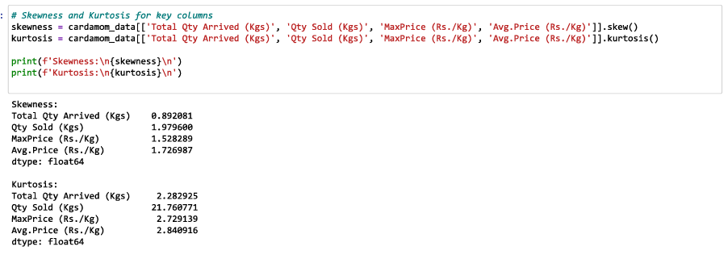
Interpretation of Skewness and Kurtosis
Borcelle
Supply: Moderate right-skew (0.89), Kurtosis (2.28).
Demand: Highly right-skewed (1.98), Kurtosis (21.76).
Prices: Right-skewed distribution with outliers.
Interpretation: Most prices are low to moderate, but some auctions had much higher average prices.
The cardamom auction market exhibits volatility, driven by outliers in both sales and pricing,
Organic Food
Presentations are tools that can be used as lectures.
Notes:
"We also analyzed the skewness and kurtosis of the data to understand its distribution:
Skewness measures whether the data is symmetrical or skewed. For example, the skewness of supply is moderate right-skewed at 0.89, meaning there are more auctions with lower supply but a few with significantly higher quantities.
Kurtosis measures the presence of outliers. The kurtosis of demand is extremely high at 21.76, indicating that there are extreme spikes in some auctions' sales volumes."
Skewness: Skewness shows if the data is uneven. When it's right-skewed (positive skewness), it means most of the values are small or low, but a few values are very high, creating a long tail on the right side of the chart. If skewness is negative, the long tail would be on the left, meaning there are some very low values.
Positive Skewness (Right-Skewed): Most values are low, but a few are high.
Negative Skewness (Left-Skewed): Most values are high, but a few are very low.
Kurtosis: This shows how many extreme values (outliers) there are. If the kurtosis is high (above 3), it means there are more extremely high or extremely low values compared to normal, so the data has heavy tails. If it's low (below 3), the data has fewer extreme values.
High Kurtosis (> 3): There are more extreme outliers (very high or very low values).
Low Kurtosis (< 3): Extreme outliers are less common or not as extreme.
Total Qty Arrived (Kgs):
Skewness: 0.89 (Moderate right-skew)
Kurtosis: 2.28 (Close to normal)
Interpretation: There are more auctions with lower supply, but a few have significantly larger quantities.
Qty Sold (Kgs):
Skewness: 1.98 (Highly right-skewed)
Kurtosis: 21.76 (Extremely high kurtosis)
Interpretation: Majority of auctions sold fewer quantities, with some having extreme spikes in sales.
Max Price (Rs./Kg):
Skewness: 1.53 (Highly right-skewed)
Kurtosis: 2.73 (Near-normal)
Interpretation: Some auctions experienced significantly higher prices due to demand, but these are rare
.
Avg Price (Rs./Kg):
Skewness: 1.73 (Highly right-skewed)
Kurtosis: 2.84 (Near-normal)

Slide 10
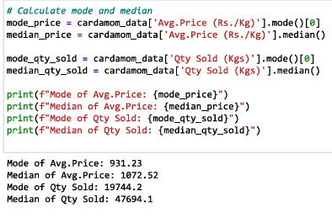
Mode and Median Analysis of Cardamom Data
Borcelle
Mode of Avg. Price (Rs./Kg): 931.23
Median of Avg. Price (Rs./Kg): 1072.52
Mode of Qty Sold (Kgs): 19744.2
Median of Qty Sold (Kgs): 47694.1
Organic Food
Presentations are tools that can be used as lectures.

Slide 11
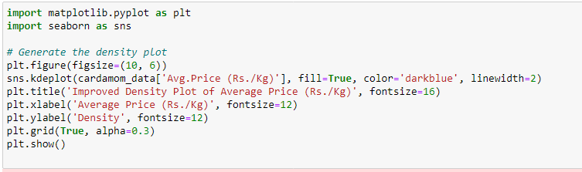
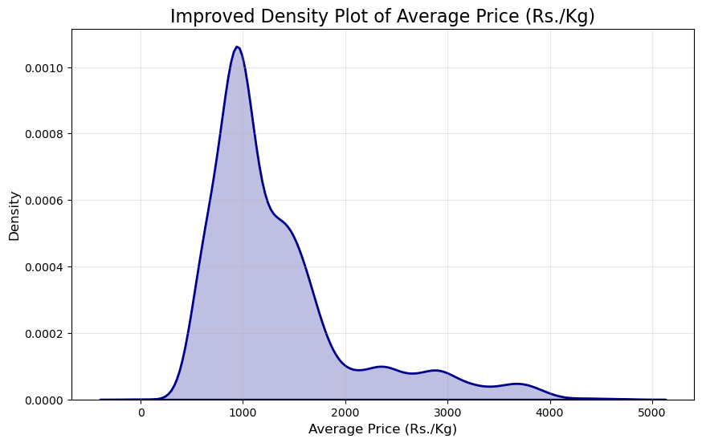
Borcelle
Density Plot of Average Price (Rs./Kg)
Presentations are tools that can be used as lectures.
Notes:
Peak at ~₹1000: The plot shows a clear peak just below ₹1000 per kg. This suggests that the majority of the average prices cluster around this value.
Price Variation: The long right tail and steep peak confirm that the cardamom prices are typically around ₹1000, with some variance extending to higher prices, but extreme high prices are rare.

Slide 12
Borcelle
Density Plot of Average Price (Rs./Kg)
Peak at ~₹1000: The plot shows a clear peak just below ₹1000 per kg. This suggests that the majority of the average prices cluster around this value.
Price Variation: The long right tail and steep peak confirm that the cardamom prices are typically around ₹1000, with some variance extending to higher prices, but extreme high prices are rare.
Presentations are tools that can be used as lectures.

Slide 13
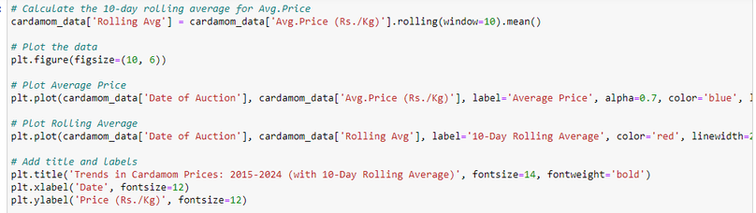
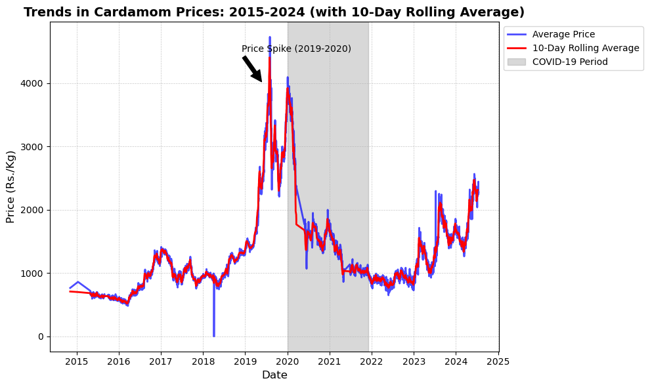
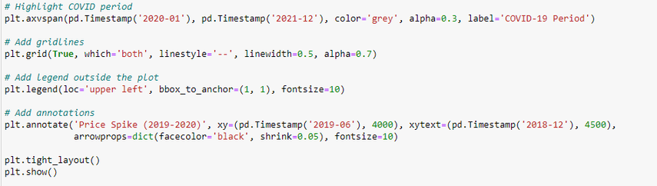
Borcelle
Analysis and Interpretation of the Rolling Average Chart
Presentations are tools that can be used as lectures.

Slide 14
Analysis and Interpretation of the Rolling Average Chart
Borcelle
Price Trends:
The graph shows the trend of cardamom prices from 2015 to 2024.
A noticeable price spike occurred during the period of 2019-2020.
Significant Price Spike (2019-2020):
The average price of cardamom saw a sharp increase, reaching over Rs. 4000 per kg during this period.
This spike can be attributed to various factors, including supply shortages, high demand, and speculation.
Impact of COVID-19 (2020-2021):
The shaded region in the graph represents the COVID-19 period (2020-2021).
During this time, the prices dropped significantly post-spike but remained above pre-spike levels.
The pandemic disrupted supply chains, affecting the market dynamics of cardamom.
Post-COVID-19 Recovery and Stabilization:
Post-2021, prices began to stabilize with some fluctuations.
There is a gradual increase in prices as the market recovers from the pandemic's impact, with current levels trending upwards towards Rs. 3000 per kg.
Presentations are tools that can be used as lectures.

Slide 15
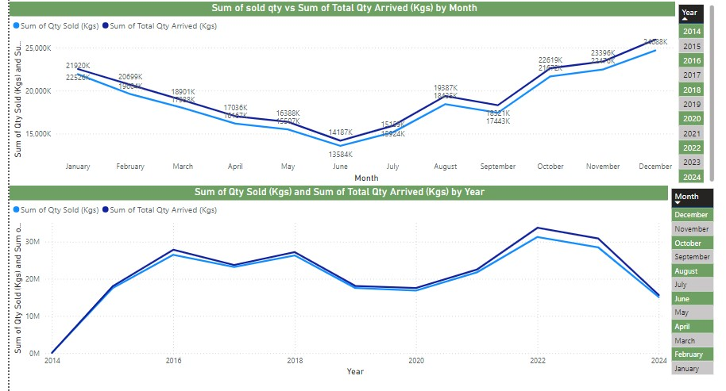
Supply vs. Demand Analysis by Month (2015 - 2024)
Borcelle
General Trend (2024): Both the quantity sold (light blue line) and the total quantity arrived (dark blue line) follow a similar pattern throughout the years.
Decline in Supply and Demand (January to July): Both supply and demand steadily decline from January to July, hitting their lowest points in July
Recovery in Late 2024: From August onwards, there is a sharp rise in both sold and arrived quantities, peaking in December
Balanced Market: The lines remain closely aligned throughout the year, suggesting that supply is well matched by demand in 2024.
Presentations are tools that can be used as lectures.

Slide 16
Supply vs. Demand Analysis by Year (2015 - 2024)
Borcelle
Rapid Growth (2015-2017): The total quantity sold and arrived increases sharply between 2015 and 2017, reflecting strong growth in the cardamom market during this period.
Market Plateau (2017-2020): The market stabilizes between 2017 and 2020, with both sold and arrived quantities staying consistent.
Significant Decline Post-2021: After 2021, there is a clear downward trend, with both sold and arrived quantities dropping, particularly in 2023 and 2024, where the market hits its lowest point since 2017. This might indicate reduced supply, a decline in demand, or external market pressures.
Presentations are tools that can be used as lectures.

Slide 17
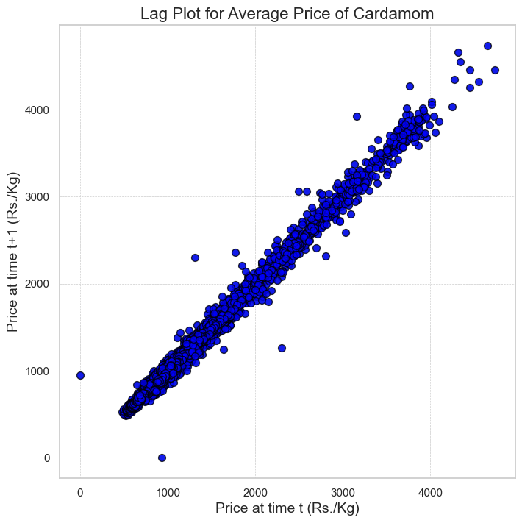
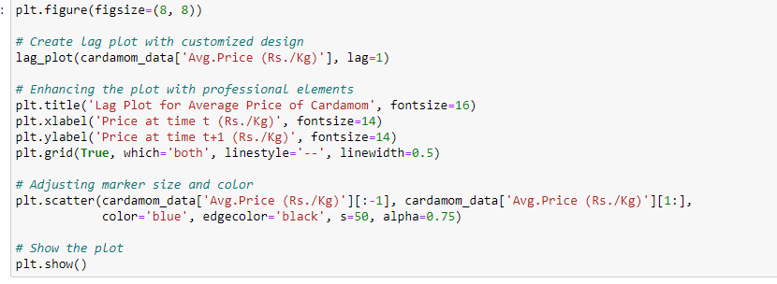
Lag Plot for Average Price
Borcelle
Lag plot indicates strong autocorrelation in prices, with gradual changes over time.
Prices are stable but influenced by previous day’s prices.
Presentations are tools that can be used as lectures.
Notes:
Strong Positive Correlation: The lag plot shows a near-perfect linear relationship between the price of cardamom at time t and t+1, indicating strong autocorrelation. Prices in this market are highly influenced by the previous day's price.
Consistency Over Time: The line's consistency suggests prices change gradually, with only a few outliers. This implies that price fluctuations tend to follow a predictable pattern, with rare abrupt shifts.
Market Stability: The consistent linear relationship implies a stable price trend, with occasional price spikes.

Slide 18
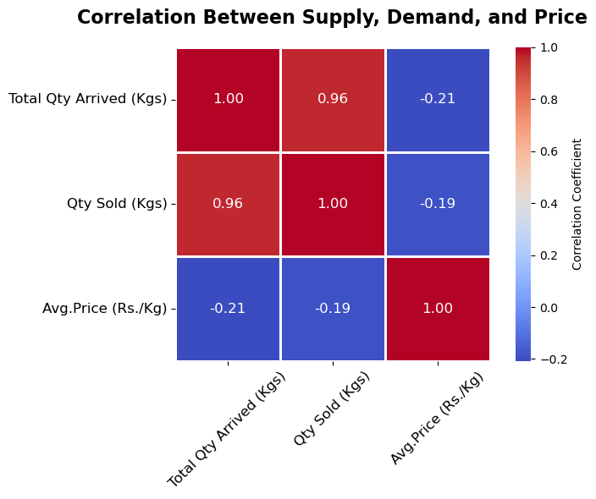
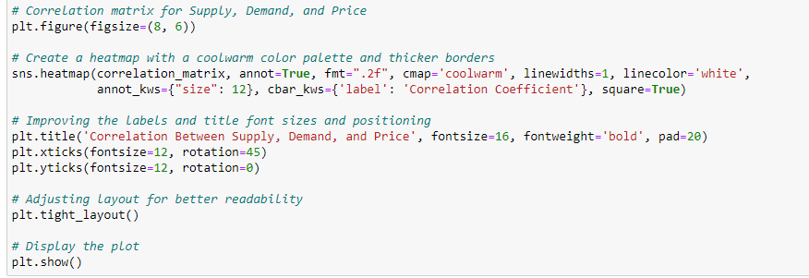
Correlation Analysis of Supply, Demand, and Price
Borcelle
Strong positive correlation between supply and demand (0.96).
Weak negative correlation between supply and price (-0.21).
Price is weakly influenced by demand (-0.19).
Presentations are tools that can be used as lectures.
Notes:
"Our correlation analysis shows:
A strong positive correlation (0.96) between supply and demand, meaning demand closely follows supply.
A weak negative correlation (-0.21) between supply and price, indicating that higher supply slightly decreases prices, but other factors like market conditions may have a larger influence on price."
Total Qty Arrived vs. Qty Sold:
Strong Positive Correlation (0.96): The quantity arriving is closely linked with the quantity sold, reflecting efficient market clearing.
Total Qty Arrived vs. Avg. Price:
Weak Negative Correlation (-0.21): Higher supply slightly pushes down the price, but the effect is not very strong.
Qty Sold vs. Avg. Price:
Weak Negative Correlation (-0.19): More sales generally lead to slightly lower prices, but other factors may influence price changes.
Supply & Demand: Highly correlated, suggesting market efficiency in absorbing supply.
Price Sensitivity: Weakly impacted by supply and demand, indicating that price is influenced by other factors like quality, seasonality, or external market forces

Slide 19
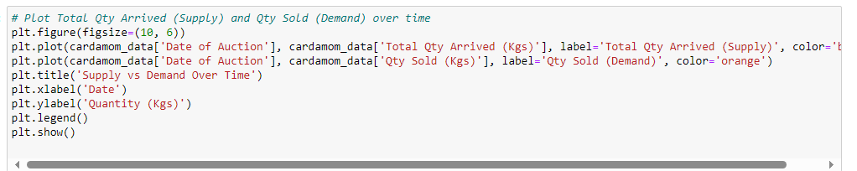
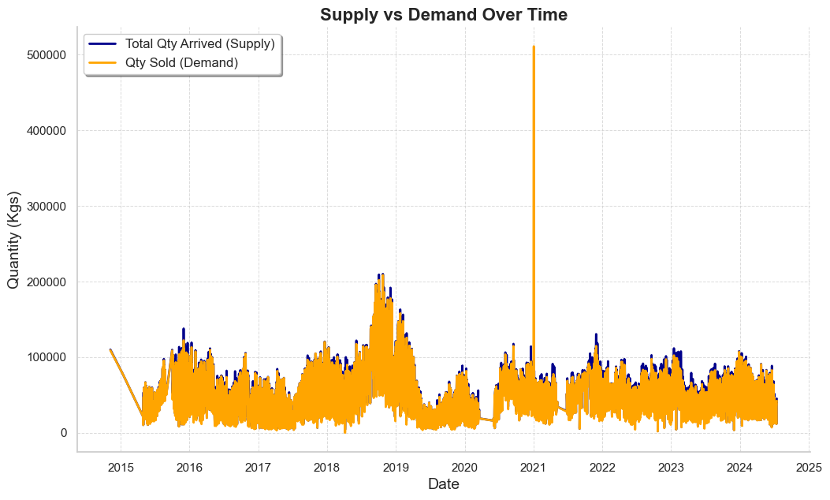
Supply vs. Demand Over Time
Borcelle
Presentations are tools that can be used as lectures.
Notes:
The plot compares Total Quantity Arrived (Supply) with Quantity Sold (Demand) for cardamom from 2015 to 2025.
The orange line (Qty Sold) mostly follows the blue line (Total Qty Arrived), indicating demand generally matches supply.
Notable spike in 2021 shows surplus in supply, suggesting a one-time event.
Between 2017-2019, clear seasonal patterns are visible.
Post-2021, supply and demand stabilize.

Slide 20
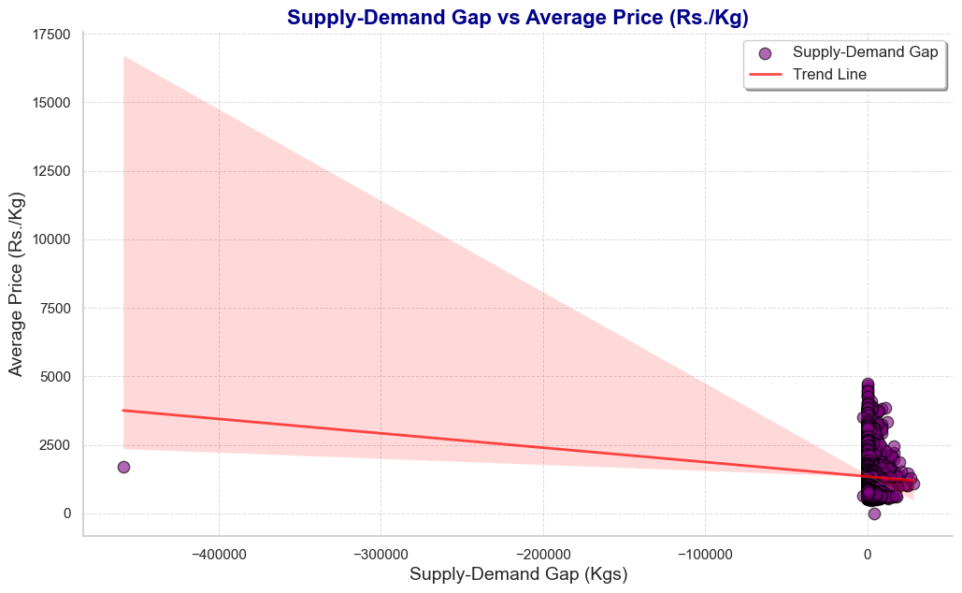
Borcelle
Supply-Demand Gap vs Average Price Analysis
Weak inverse relationship between supply-demand gap and prices.
Other factors (e.g. market forces, quality) likely influence prices more.
Presentations are tools that can be used as lectures.
Notes:
The Supply-Demand Gap is calculated as the difference between the quantity of cardamom arrived (supplied) and the quantity sold (demanded).
Negative values (on the left side of the x-axis) represent a supply shortage, where more demand exists than supply (i.e., demand > supply).
Values closer to zero indicate a balance between supply and demand, where the supply almost meets the demand.
Inverse Relationship: As the supply-demand gap becomes more negative (indicating a shortage), the average price slightly decreases.
The relationship is weak, indicating other factors besides supply and demand likely influence prices.
There is no significant price increase when demand exceeds supply.
Instead, the price slightly decreases during shortages, indicating market irregularities where price dynamics do not strictly follow supply-demand trends.
Most data points are concentrated near the zero mark on the x-axis, showing that the market typically operates with a relatively balanced supply and demand.
One notable data point shows a large supply shortage with a high price (~Rs. 2500/kg), which could be an outlier.

Slide 21
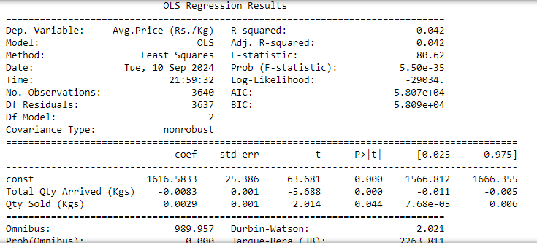
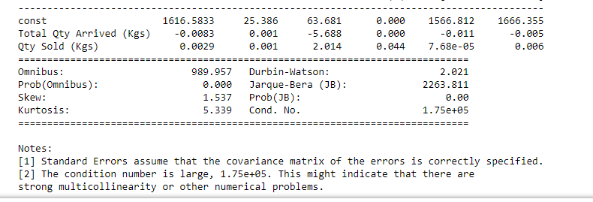
Borcelle
Interpretation of OLS Regression Results
Model Summary (Training Data)
- R-squared: 0.042 -
F-statistic: 80.62 (p < 0.05)
Model Evaluation (Test Data)
R-squared: 0.0517
Presentations are tools that can be used as lectures.

Slide 22
Borcelle
Interpretation of OLS Regression Results
Total Qty Arrived (Kgs): -0.0083
For every additional kilogram arriving in the market, the price decreases by Rs. 0.0083. This aligns with the law of supply.
Qty Sold (Kgs): 0.0029
For every additional kilogram sold, the price increases by Rs. 0.0029. This reflects the law of demand.
Inverse Relationship: As supply increases, price tends to decrease.
Positive Relationship: As demand increases, price tends to increase slightly.
Low Explanatory Power: Both the training and test R-squared values are low, indicating that other factors beyond supply and demand impact cardamom prices.
Presentations are tools that can be used as lectures.

Slide 23
Borcelle
Conclusion
Cardamom Auction Trends (2015-2024): Significant fluctuations in supply, demand, and pricing across auctions, indicating a volatile market.
Key Findings:
Highly variable supply and demand levels, leading to price volatility.
Price spikes during specific periods (e.g., 2019-2020) due to factors like supply shortages and external disruptions (e.g., COVID-19).
Market efficiency reflected in the strong correlation between supply and demand, although price sensitivity to these factors is relatively weak.
Skewness and kurtosis analyses reveal occasional extreme price and quantity outliers, contributing to market unpredictability.
OLS Regression: Limited explanatory power of supply and demand in predicting prices suggests that other factors (e.g., quality, seasonality, external market forces) play a significant role in price determination.
Presentations are tools that can be used as lectures.

Slide 24



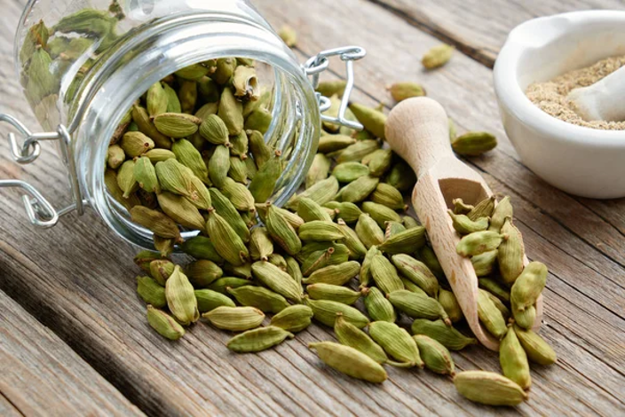

Thank You

